Slide 1

BHARTIYA SKILL DEVELOPMENT UNIVERSITY
Faculty of computing skills education
Project Title : Sun Blaster
Midterm Final Presentation
Rikvender singh Rajawat
210611s009

Slide 2
INTODUCTION
At Sun Blaster we empower indoor gardening enthusiasts to cultivate their love, confidence, knowledge and involvement in home horticulture.
By optimizing the indoors, Sun Blaster turns growing season into a year-round hobby. Our comprehensive line of grow gardens, seeds starters, lighting and accessories are easy to use, perform flawlessly and seamlessly fit into home decor.
Sun Blaster's commitment to quality and innovation has made it a trusted choice for both beginners and experienced growers looking to optimize their indoor gardening efforts. Whether you're starting seeds, growing herbs, nurturing houseplants, or cultivating specialty crops, SunBlaster offers a range of lighting solutions to help you achieve successful and healthy plant growth.

Slide 3
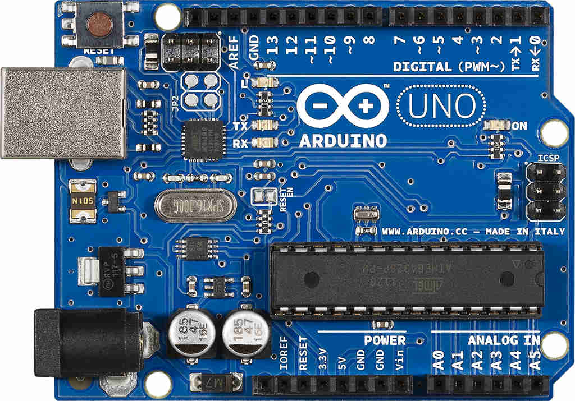
COMPONENTS
CONTROLLER

Slide 4
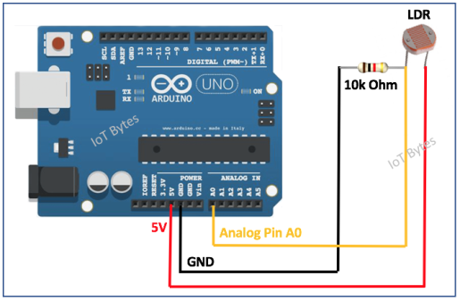
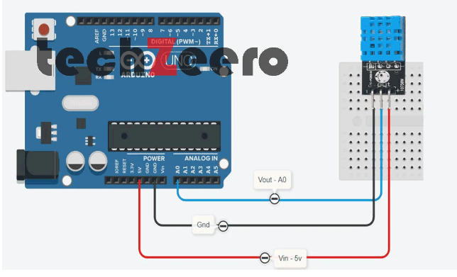
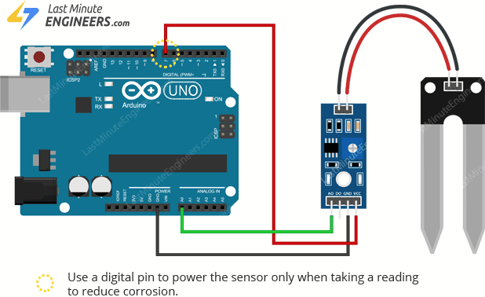
CRICKET DIAYAGARM

Slide 5
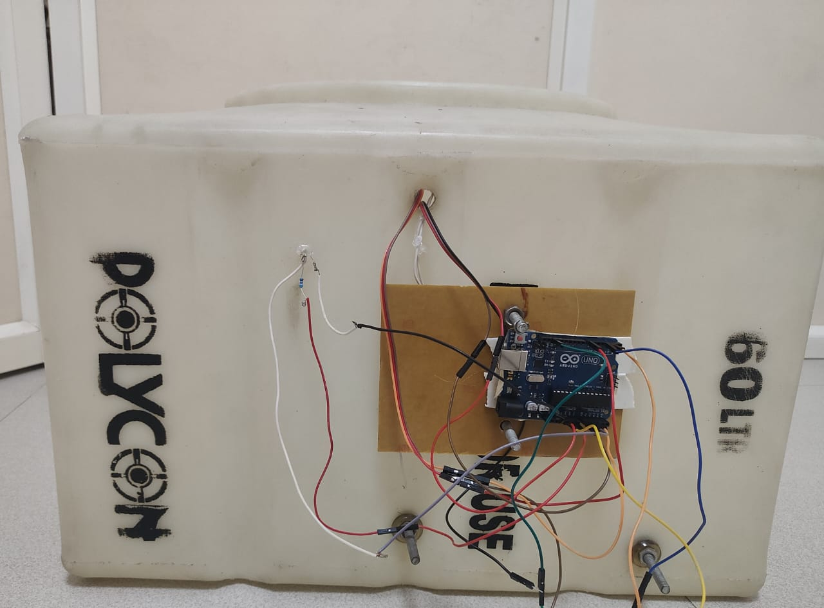
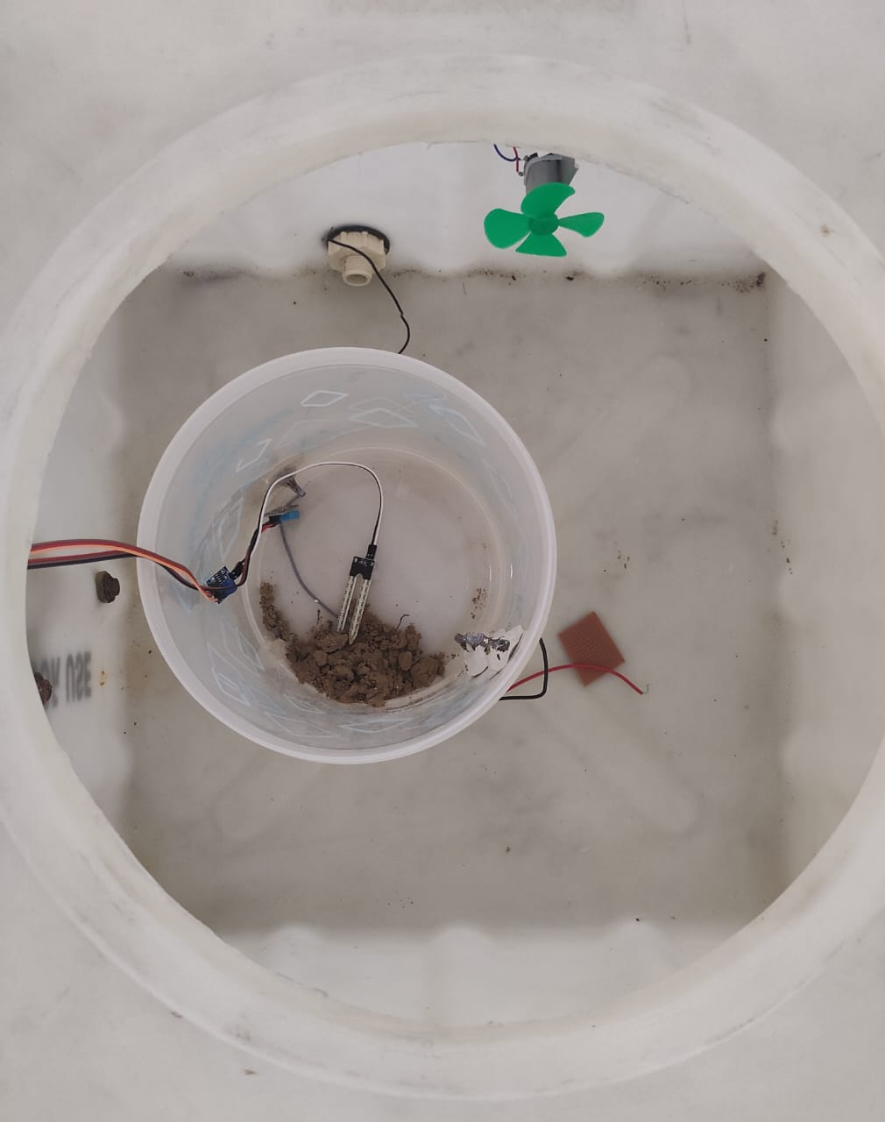
CHESES DESIGN
FRAME

Slide 6
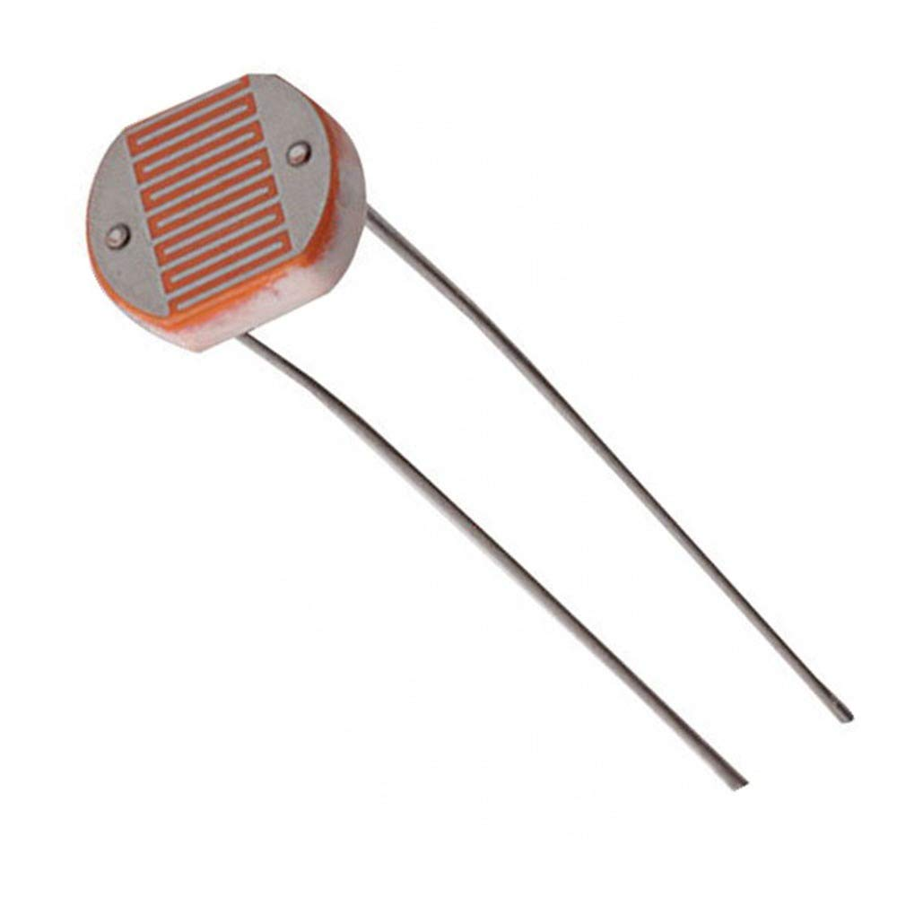
Implementation of LDR Code
LDR CODE
void loop(){
LDRReading = analogRead(LDR); // Reading LDR Input.
Serial.println(LDRReading); // Printing LDR input value.
if (LDRReading >threshold_val){ // Condition to make LED ON.
lEDBrightness = map(LDRReading, 0, 1023, 0, 255); // Converting LDR to LED Brightness.
analogWrite(LED, lEDBrightness); // Writing Brightness to LED.
}
else{
analogWrite(LED, 0); // If LDR is below threshold make LED OFF.
}
delay(300); // delay to make output readable on serial monitor.
}

Slide 7
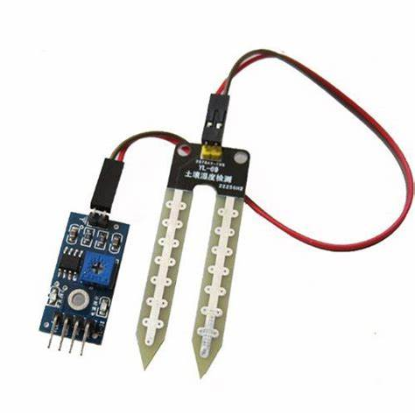
Implementation of Moisture sensor
MOISTURE SENSOR
void loop() {
//get the reading from the function below and print it
Serial.print("Analog output: ");
Serial.println(reaDHT11 SENSOR CODE
dSensor());
delay(1000);
}
// This function returns the analog soil moisture measurement
int readSensor() {
digitalWrite(sensorPower, HIGH); // Turn the sensor ON
delay(10); // Allow power to settle
int val = analogRead(sensorPin); // Read the analog value form sensor
digitalWrite(sensorPower, LOW); // Turn the sensor OFF
return val; // Return analog moisture value
}

Slide 8
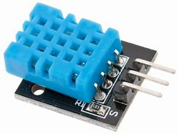
Implementation of DHT11 sensor Code
DHT11 SENSOR CODE
void loop()
{
DHT.read11(dht_pin);
Serial.print("Humidity = ");
Serial.print(DHDHT11 SENSOR CODE
T.humidity);
Serial.print("% ");
Serial.print("Temperature = ");
Serial.print(DHT.temperature);
Serial.println(" C");
delay(5000); //Reduce Time for Quick Reply
}

Slide 9
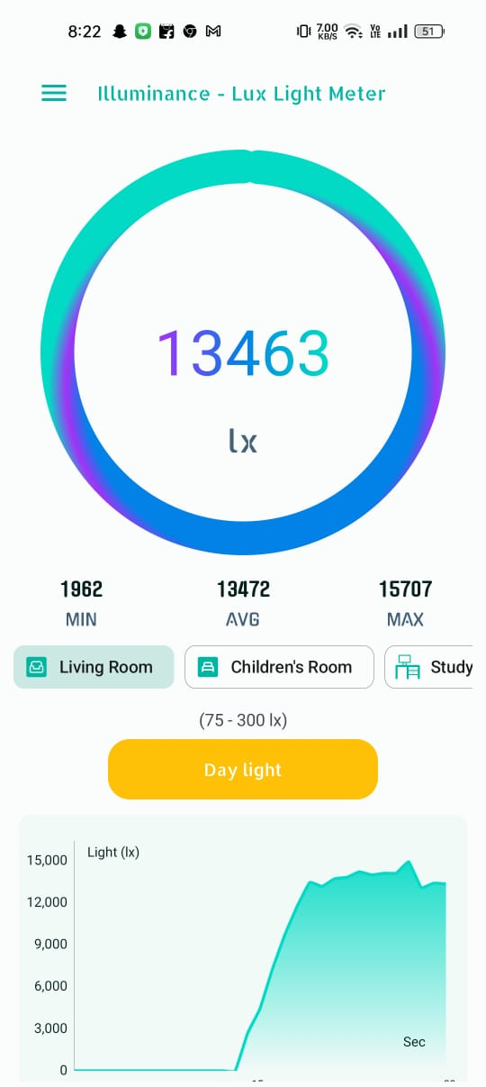
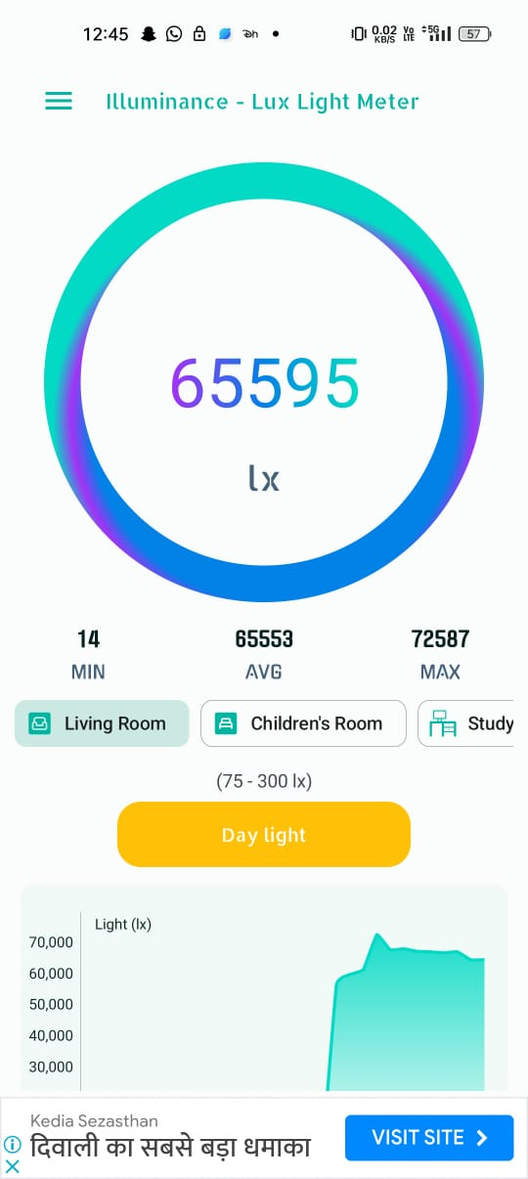
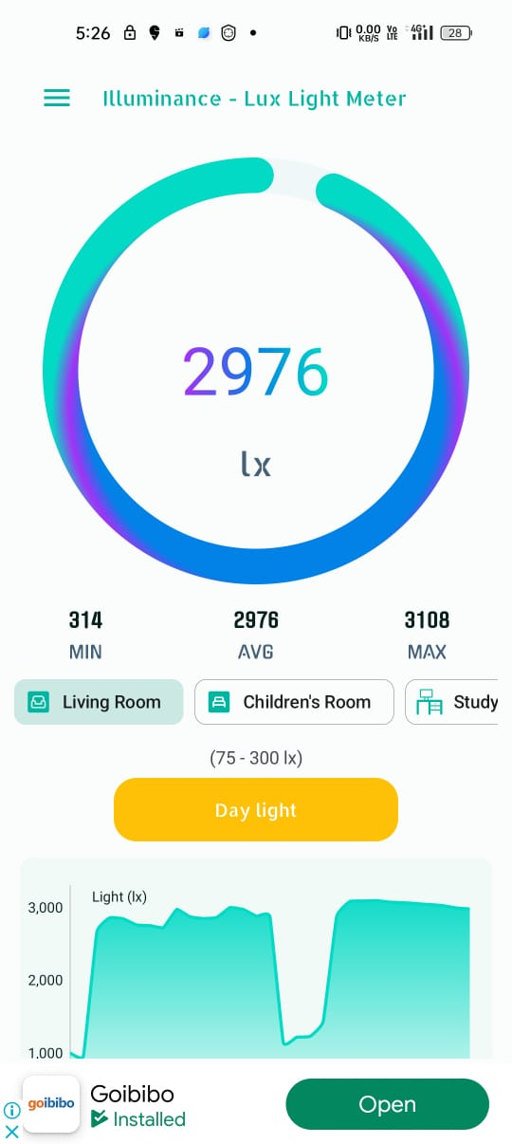
Lux App Data @ value at 8.22 am , 12.45 pm , 5.26 pm

Slide 10
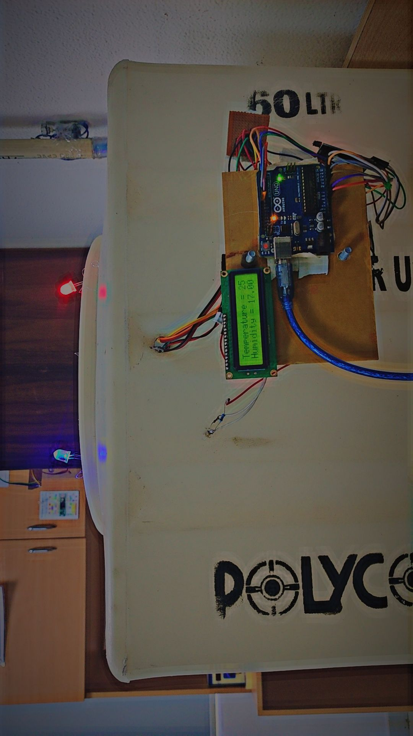
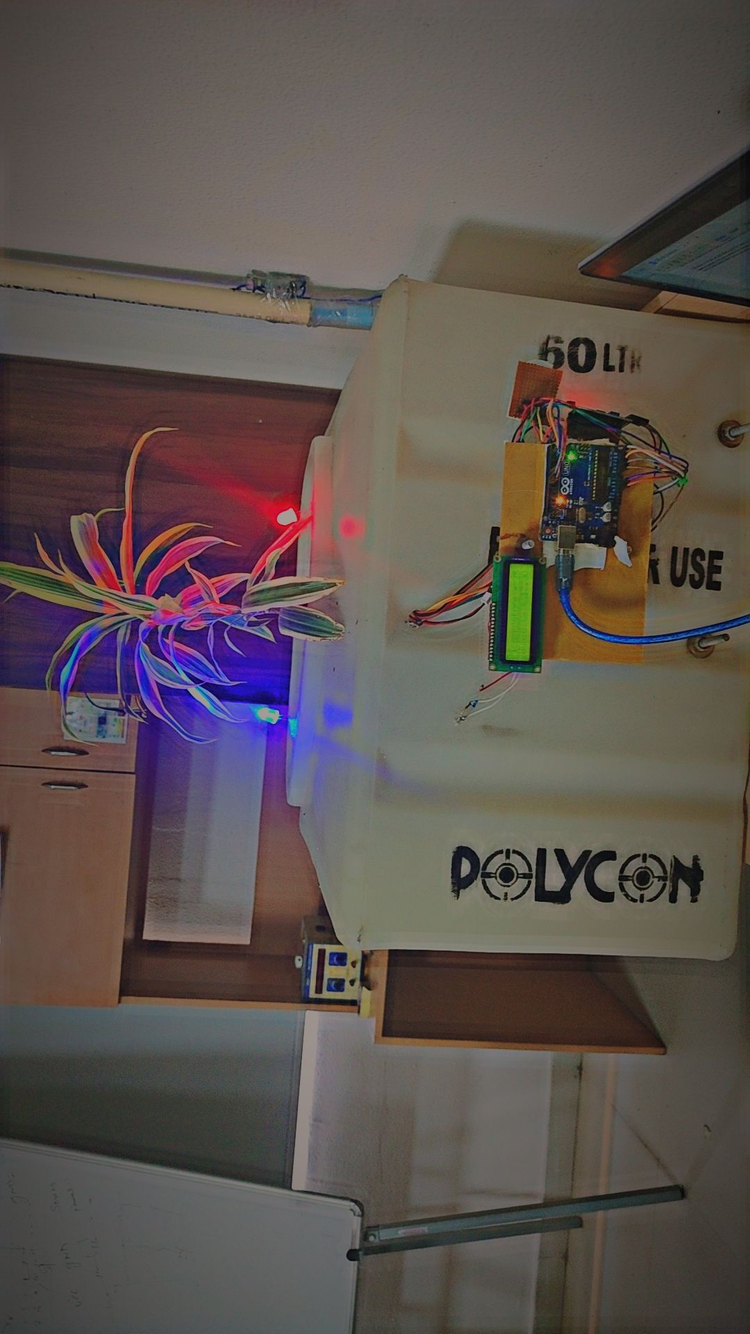
Final project Implementation

Slide 11


